Slide 1
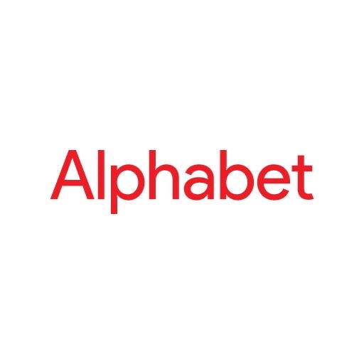
Alphabet Inc. (Google)
Name:- Sai Parthish Mandumula
Student Id:- 1002022847
2232-CSE-5325-002-Software Engineering ll.

Slide 2
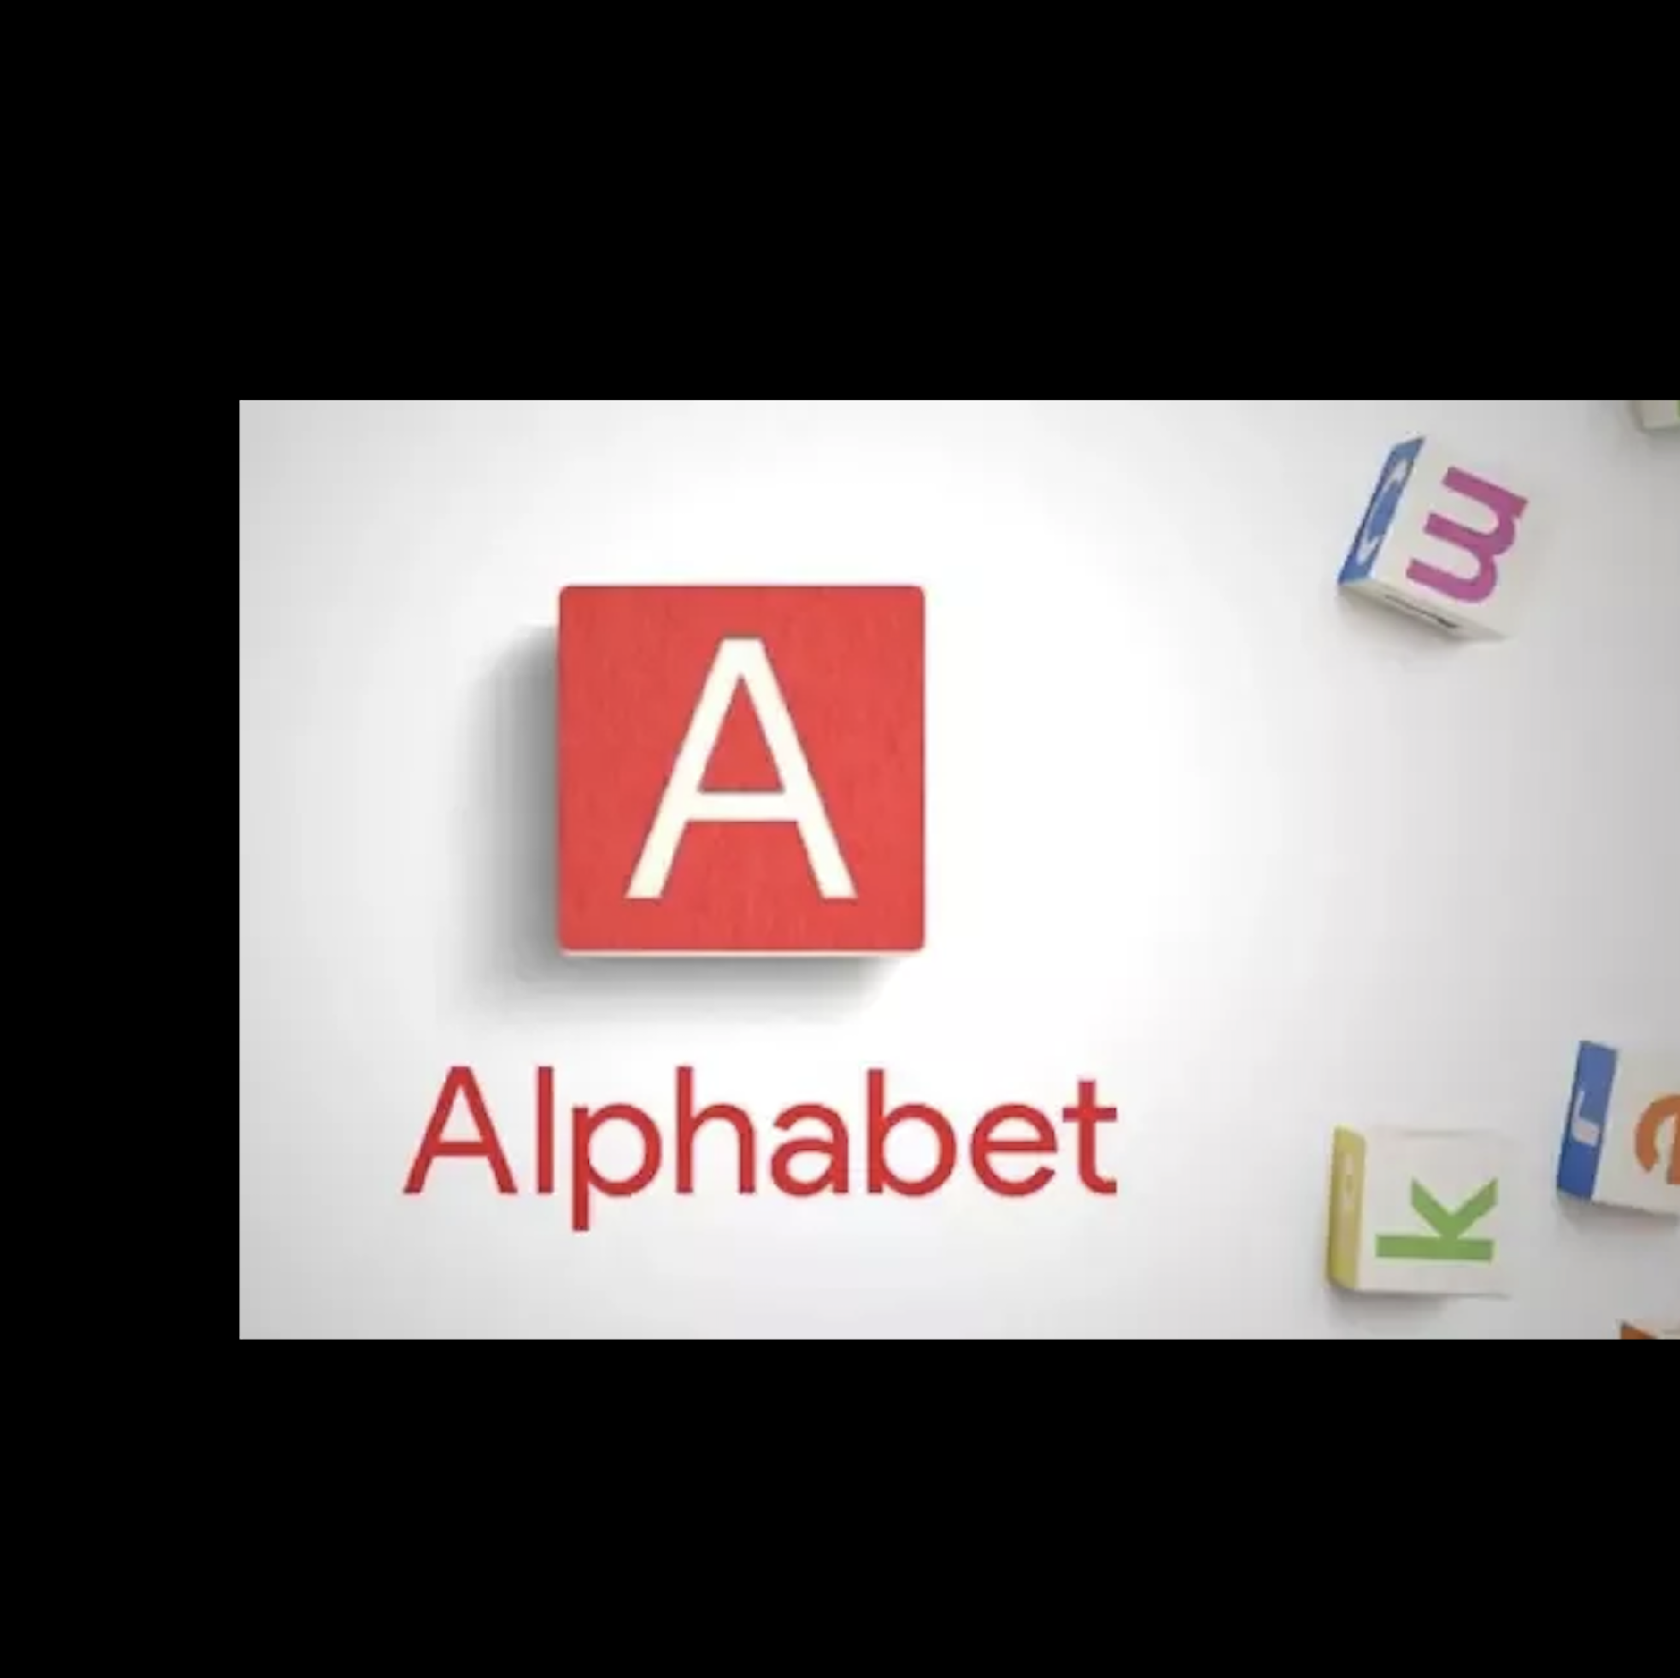
Alphabet Inc. (Google)
Alphabet Inc. is a multinational conglomerate holding company headquartered in Mountain View, California, United States.
The business is renowned for its innovative thinking, cutting-edge technology, and socially conscious use of its goods and services.

Slide 3
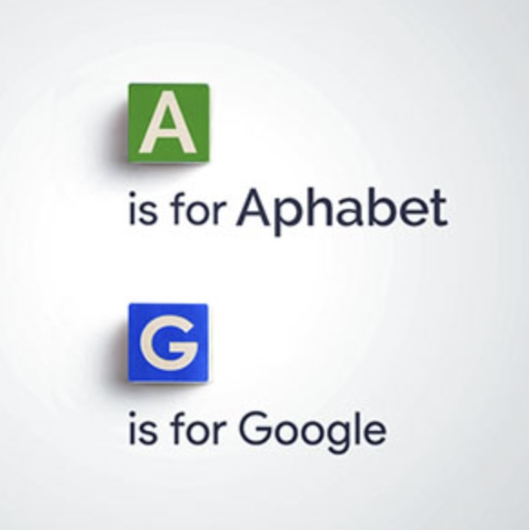
HISTORY
On August 10, 2015,Larry Page Google Inc. announced plans to create a new public holding company, Alphabet Inc.
The co-founders of Google, Larry Page and Sergey Brin, are also the co-founders of Alphabet Inc They serve as Alphabet's CEO and President respectively.
It was created through a restructuring of Google on October 2, 2015,and became the parent company of Google and several former Google subsidiaries.

Slide 4

Management Style/Philosophy
The main philosophy behind the creation of Alphabet Inc. (Google) was to streamline the management of Google's many businesses and investments, while also providing a framework for future growth and innovation.
Decentralized decision-making:
Each subsidiary of Alphabet has a high level of autonomy, enabling it to take choices without asking the company's top management's consent.

Slide 5
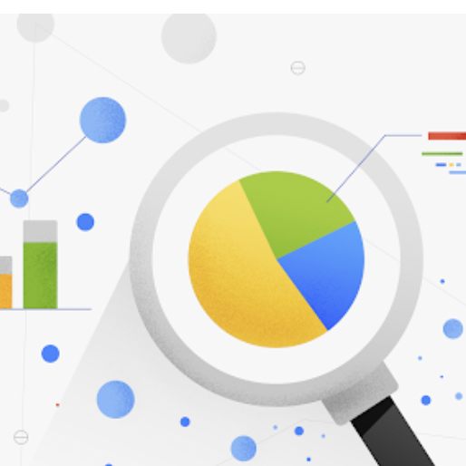
Management Style/Philosophy
Data-driven decision-making:
Alphabet Inc. is a major advocate of leveraging data and analytics to make wise choices. Data are used by the organization to assess the performance of various efforts, and innovation is encouraged.
Flat organizational structure:
Alphabet Inc. has an organizational structure that is comparatively flat, with few hierarchical tiers separating lower-level staffers from high management. The collaboration and communication between teams is encouraged by this arrangement.

Slide 6
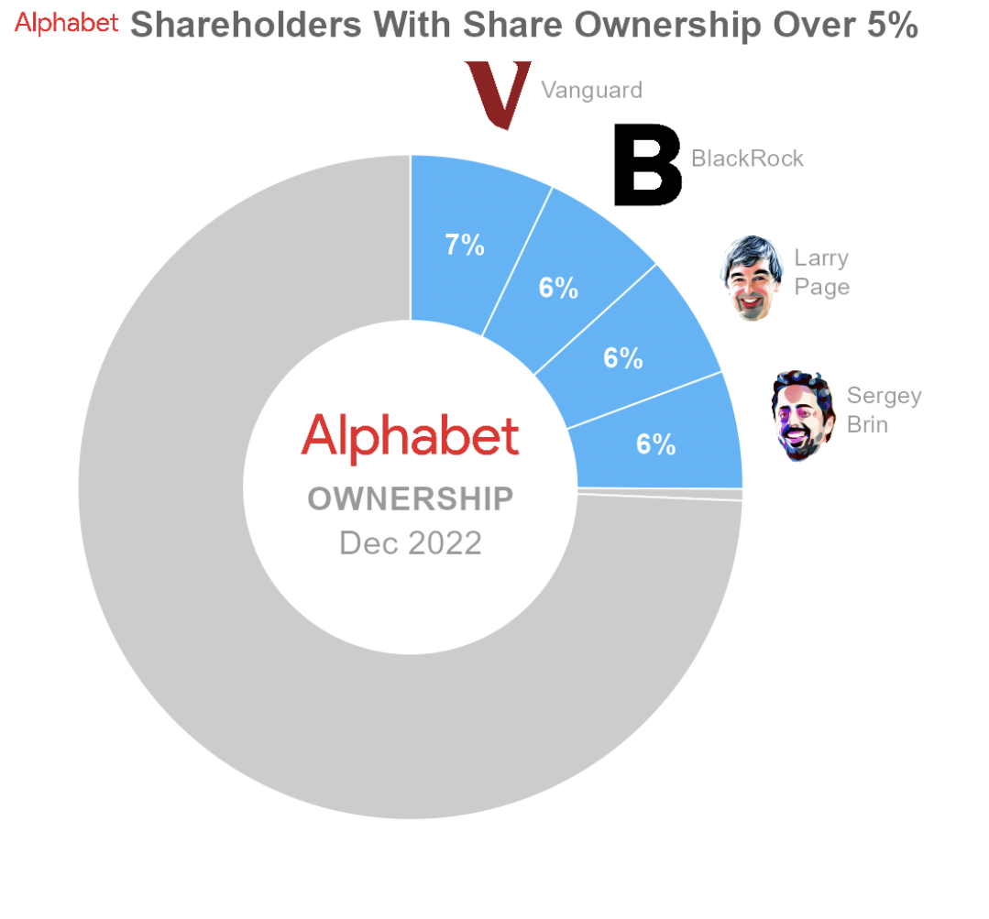
KEY PEOPLE
Vanguard: Investment Management Company
Black Rock : Investment Mangement Company
Larry Page : CEO of Alphabet from 2015-2019
Sergey Brin: President of Alphabet from 2015 - 2019
Sundar Pichai: CEO of Alphabet from 2019 .

Slide 7
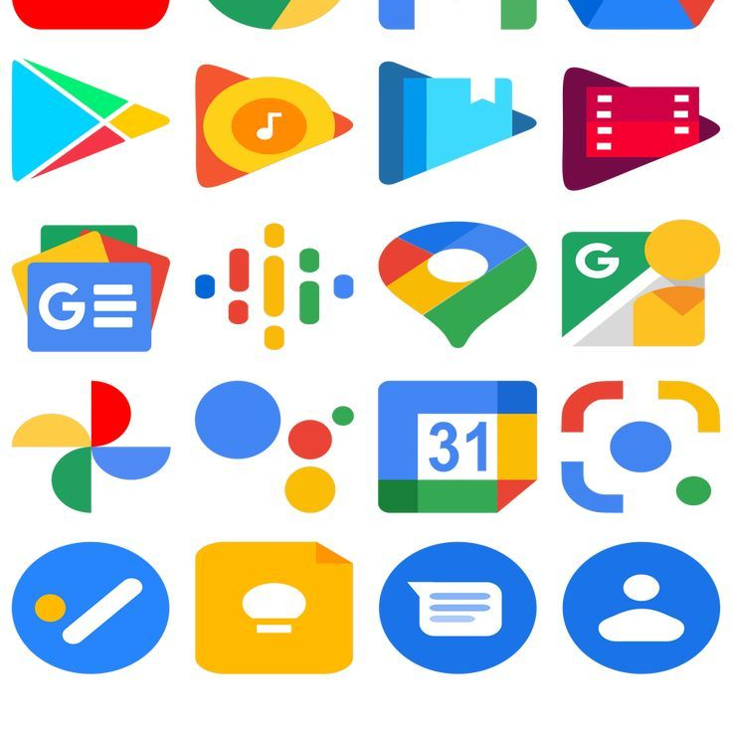
Applications
Alphabet Inc. is a multifaceted multinational with a broad variety of operations and products. Alphabet has several products and services, some of which are as follows:
Software services:
Search engines :- GOOGLE,CHROME,YOUTUBE
Cloud Services :- GOOGLE CLOUD PLATFORM
operating system :- Andorid OPERATING
Advertising:
Google's, allows companies to target their ads at particular demographics and track the success of their products major platform like YouTube.

Slide 8
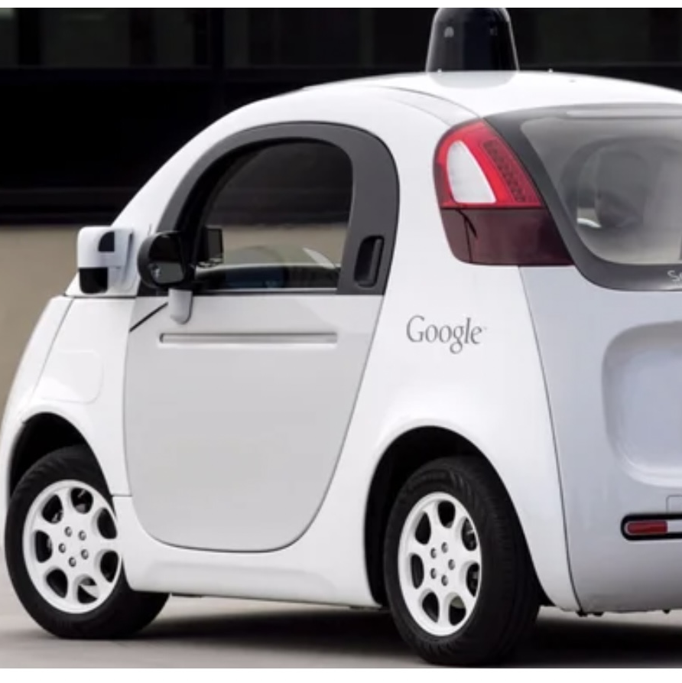
Companies/Institutions
Autonomous vehicles:
Alphabet's Waymo division is a pioneer in the development of self-driving which has the potential to transform transportation and lower the number of accidents brought on by human error.
Healthcare:
The Verily division of Alphabet is committed to utilizing technology to enhance healthcare results. Projects range from smart contact lenses to cutting-edge medical imaging

Slide 9
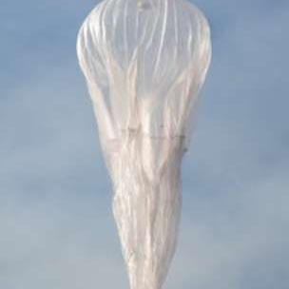
Companies/Institutions
Robotics:
With initiatives ranging from drone delivery to robotic arms for manufacturing, Alphabet has extensively invested in robotics technology.
Internet access:
With initiatives like Project Loon, which employs high-altitude balloons to offer internet connectivity, and Google Fiber, Alphabet's Access business is focused on increasing internet access in developing areas

Slide 10

Opinion
Alphabet Inc is pioneer in research and development arms Google x focuses on developing cutting-edge technologies such as self driving cars and internet-beaming balloons.
Decentralized decision-making is the key management style for the company success.
Alphabet is working on applying technology to a broad array of life sciences issues, with separate projects dedicated to studying diabetes, cancer, wearables, robotic surgery, population health, and pharmaceuticals.

Slide 11

Quiz
Q1) In which year Alphabet Inc is found?
A) 08-10-2015 B) 06-29-2014 C) 01-12-2017 D) 08-11-2015
Q2) When Alphabet Inc became parent Company?
A) 09-12-2015 B) 10-02-2015 C)06-29-2018 D)12-12-2018
Q3) Who is the present CEO of the Company?
A) Tom Curry B)Sundy C) Larry Page D) Sundar Pichai
Q4) Which one is the management style of Alphabet Inc?
A) Decentralized decision making B) Centralized decision making C)Master slave D) None
Q5) Which is the management /products of Alphabet Inc?
A) FaceBook B) Whats APP C) Google D) Tesla

Slide 12
References
https://en.wikipedia.org/wiki/Alphabet_Inc.
https://abc.xyz/
https://www.statista.com/topics/6042/alphabet-inc/#topicOverview

Slide 13

Thank you

